Slide 1
Network Service Platform/Network Automation
Arun Kumar, Siva Prasad
30-June-2020

Slide 2
Agenda
Introduction on NMS/EMS
Overview of standards ad FCAPS
Overview of EMS/NMS functionality
Overview of Management Protocols
Break
Introduction to NSP
Service Orchestration (SF) & live Demo
Workflow manager (WFM) high level overview

Slide 3
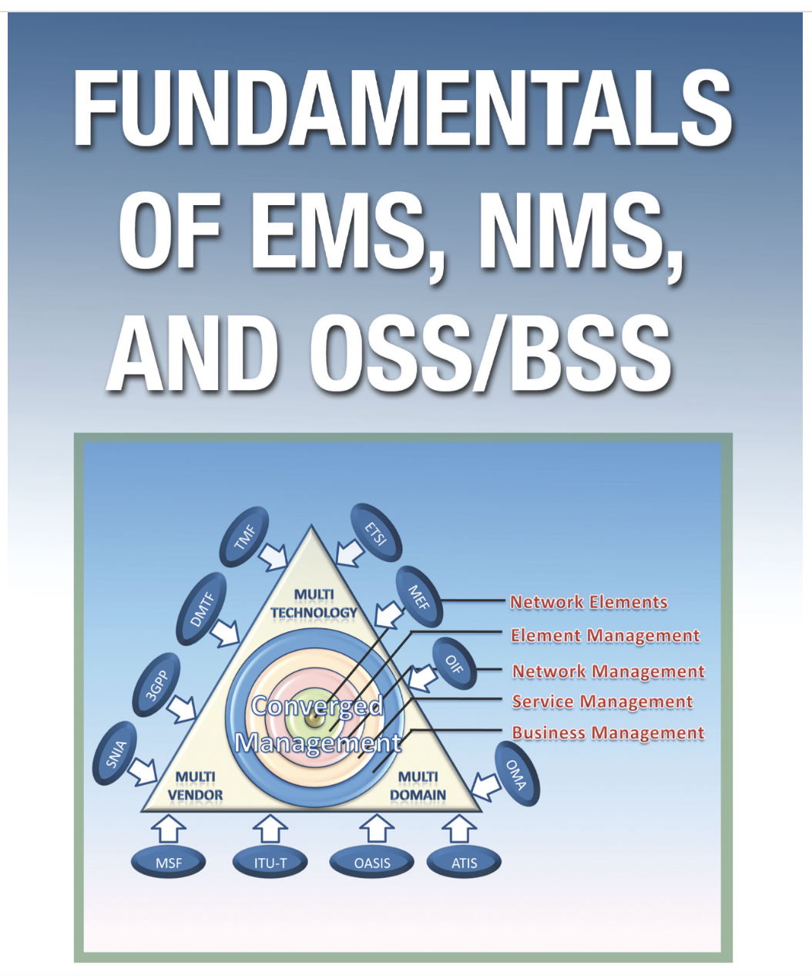
Notes:
The course is aimed to cover the basics of telecom management, from legacy management systems to the next generation systems.
Element management systems (EMS),
Network management systems (NMS), and
Operation/business support systems (OSS/BSS) through concepts, functionality descriptions, applicable protocols, and implementation guidelines.
The communication service industry is moving toward a converged world where services like data, voice, and value-added services are available anytime and anywhere. The services are “always on,” without the hassle of waiting or moving between locations to be connected or for continuity in services. The facilities offer easy and effortless communications, based on mobility and personalized services that increase quality of life and lead to more customer satisfaction. Service providers will have much more effective channels to reach the customer base with new services and applications. With changes in services and underlying networks, the ease in managing the operations becomes critically important. The major challenge is changing business logic and appropriate support systems for service delivery, assurance, and billing.
Operations support systems (OSS) as a whole includes the systems used to support the daily operations of the service provider. These include business support systems (BSS) such as billing and customer management, service operations such as service provisioning and management, element management, and network management applications. In the layered management approach, BSS corresponds to business management and OSS corresponds to service management, while the network level operation support is done using a network management system and individual resources are managed with an element management system.

Slide 4
What is EMS ?
A network element is the hardware on which a process or set of processes is executed to offer a service or plurality of services to the customer.
EMS is an application that manages a telecom network element.
an element manager (EM) collects data from the network elements (NE).
Layered view of an element management system
Notes:
Industries are highly dependent on their networking services for day-to-day activities from sending mail to conducting an audio/video conference. Keeping services running on the resource is synonymous with keeping the business running. Any service is offered by a process or set of processes running on some hardware. A set of hardware makes up the inventory required for keeping a service up and running. If the hardware goes down or when there is some malfunction with the hardware, this would in turn affect the service. This leads to the need to monitor the hardware and ensure its proper functioning in order to offer a service to a customer. This hardware being discussed is the element and an application to monitor the same constitutes the element management system. Since the element is part of a network, it is usually referred to as network element or NE.
Most element management systems are available in the market support management data collection from multiple network elements though they cannot be called a network management system. Hence an application is not necessarily a network management system just because it supports data collection from multiple NEs. The functionalities offered by the systems decide whether it is a network management system (NMS) or an element management system (EMS). Let us make this point clear with an example. A topology diagram in an EMS would have the nodes configured in the element while a topology diagram in an NMS will show all the configured network elements managed by the NMS. Again a fault management window on an EMS would show only the logs and alarms generated on the network element it is managing. The functionalities like fault correlation and decision handling based on events from various NEs are shown in an NMS.
The functionalities of an EMS are covered in detail in the chapters to follow. This introduction is intended to only give the reader a feel of what a network element and EMS is in telecom domain. In the sections to follow we will explore the architecture of EMS and take some sample EMS products to gain familiarity with EMS applications available in the market.
1.2 EMS in Telecom
As shown in Figure 1.1, an element manager (EM) collects data from the network elements (NE). An ideal scenario would involve one element manager to collect data from a single network element as in EM-2 and NE-n. It can be seen that this is not the case for an actual EMS product. Almost all the EMS products available in the market support management of a set of elements as shown for element managers other than EM-2 in Figure 1.1.
Even when data is collected from multiple NEs, the management system is still an element manager when data collection and processing is handled on a per NE basis and functionalities offered by the EM does not include any function that represents processed output from an aggregate of data collected from different NEs.
It is seen that while enhancing an EMS product or to make the product competitive in the market, many EMS solution developers offer some of the NMS related functionalities that involve processing of collected data from multiple NEs to display network representation of data. This point needs to be carefully noted by the reader to avoid getting confused when handling an actual EMS product that might include some NMS features as part of the product suite.
Figure 1.1 showing layered views closely resembles the TMN model with the network elements in the lowest layer, above which is the element management layer followed by network management layer. The TMN model is handled in much detail in Chapter 2.
The NMS server may not be the only feed that collects data from an EMS server. The EMS architecture is handled in more detail in the next section where the various feeds from an EMS sever are depicted pictorially and explained.

Slide 5
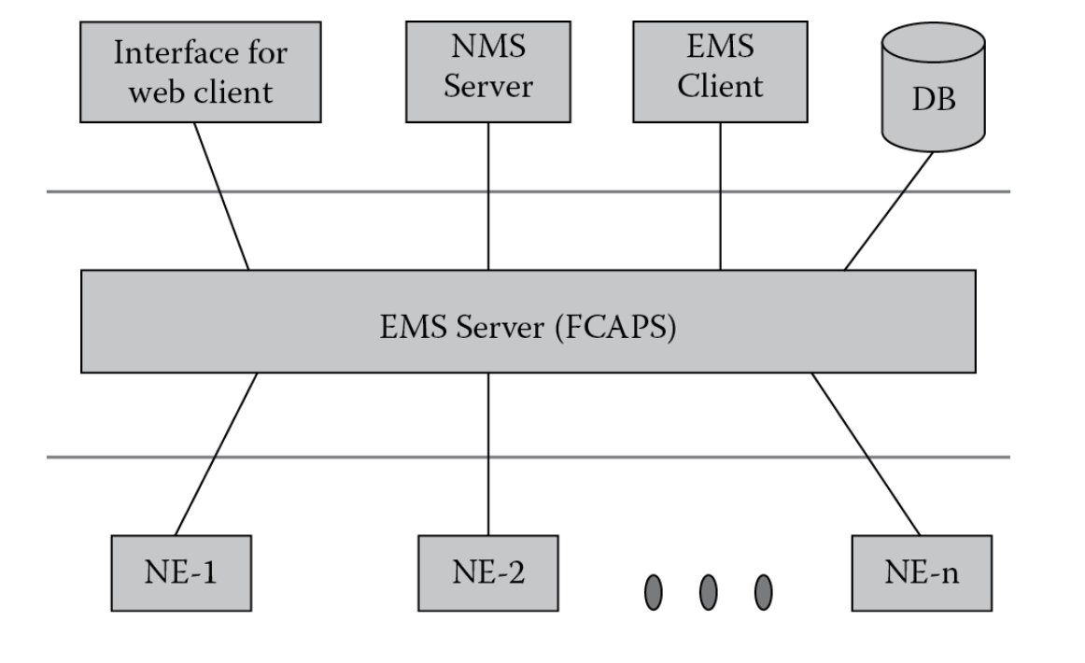
EMS Architecture
Element management system architecture
The element management system is the EMS server that provides FCAPS functionality.
The FCAPS is short for Fault, Configuration, Accounting, Performance, and Security.
Basic FCAPS functionality at element level is offered in EMS layer.
The FCAPS is also referred in conjunction with the NMS layer as an enhanced version of these functionalities come up in the NMS layer.
While EMS looks at fault data from a single element perspective, an NMS processes an aggregate of fault data from various NEs and performs operations using this data.

Slide 6
EMS Architecture
Data collected by the EMS from the network elements are utilized by:
NMS Server: The NMS uses collected as well as processed data from the EMS to consolidate and provide useful information and functionalities at a network management level.
EMS Client: If data from EMS needs to be represented in GUI or as console output to a user then an EMS client is usually implemented for the same. The EMS client would provide help in representing the data in a user-friendly manner. One of the functions in ‘F “C” APS’ is configuring the network elements. The EMS client can be used to give a user-friendly interface for configuring the elements.
Database (DB): Historical data is a key component in element management. It could be used to study event/fault scenarios, evaluate performance of the network elements, and so on. Relevant data collected by EMS needs to be stored in a database.
Interface for web client: Rather than an EMS client, most users prefer a lightweight, web-based interface to be a replacement for the web client. This functionality is supported by most EMS solutions.
The EMS output could also be feed to other vendor applications. These external applications might work on part or whole of the data from the EMS.

Slide 7
EMS Architecture
Characteristics Required in EMS
User-friendly interface: task-oriented GUI to allow operations functions to be performed in the shortest possible time with minimal training
Quick launch : enables a user working at the NML, SML, or BML to launch any EMS desired when multiple EMS are involved.
Troubleshoot NE : Allow to directly login to NE’s managed by EMS. Single-sign-on is a popular capability that allows the same user id and password to be used when logging into the applications involved in different layers of TMN model
Low-cost operations platform: help in minimizing the total cost to own and operate the computing platform on which the EMS runs.
Ease of enhancement: New features need to be added to an EMS product and the product might require easy integration and work with another product.
Context-sensitive help: This reduces the training required for technicians.
Access anywhere: This would require a person in any remote location to access the EMS.
Effective database: All possible data collected from NE needs to be stored into the EMS database. This will improve service, save time, and save money. There should also be a functionality to generate standard reports and the ability to export data to other application tools that specialize in analysis and reporting.
Notes:
Characteristics Required in EMS
The characteristics required in an EMS solution are:
User-friendly interface: The interface to work with the EMS (EMS client or web client) needs to be an intuitive, task-oriented GUI to allow operations functions to be performed in the shortest possible time with minimal training.
Quick launch: This would enable a user working at the NML, SML, or BML to launch any EMS desired (when multiple EMS are involved).
Troubleshoot NE: It should be possible for a technician to directly log into any NE from the EMS that manages it for ease in troubleshooting an issue. Single-sign-on is a popular capability that allows the same user id and password to be used when logging into the applications involved in different layers of TMN model that will be discussed in the next chapter.
Low-cost operations platform: This would help in minimizing the total cost to own and operate the computing platform on which the EMS runs.
Ease of enhancement: New features need to be added to an EMS product and the product might require easy integration and work with another product. Some of the techniques currently adopted in the design of such systems is to make it based on service oriented architecture (SOA), comply to COTS software standards, and so on.
Context-sensitive help: This reduces the training required for technicians. Context-sensitive help can be associated with any functionality in EMS GUI. With event/fault, a context-sensitive help would involve a quick launch link for information on that fault. Another usual feature in applications is a “?” icon that can be dragged and dropped to any part of the application and a help is launched on how to work on the specific part where the icon is dropped.
Access anywhere: This would require a person in any remote location to access the EMS. As already discussed most EMS now provide a web-based interface so that with secure connection technique the internet can be used to access company intranet and launch the web-based EMS.
Effective database: All possible data collected from NE needs to be stored into the EMS database. This will improve service, save time, and save money. There should also be a functionality to generate standard reports and the ability to export data to other application tools that specialize in analysis and reporting.
Above all, the key to being a leader in EMS development is to make the product functionality rich and to ensure that there are key features that differentiate the product from its competitors.

Slide 8
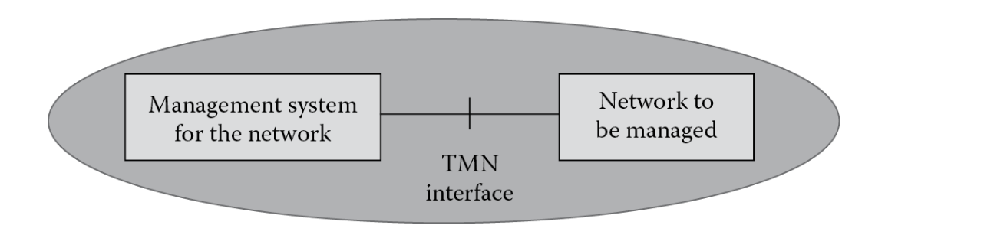
TMN Model
Introduction
TMN stands for Telecommunications Management Network
The concept of TMN was defined by ITU-T in recommendation M.3010 (International Telecommunication Union-Telecommunication Standardization Bureau)
The telecommunications management network is different from a telecommunication network.
While the telecom network is the network to be managed, TMN forms the management system for the network to be managed.
TMN and telecom network

Slide 9
TMN Model
TMN recommendation
Recommendation Number | Title
M.3000 | Overview of TMN recommendations
M.3010 | Principles for a TMN
M.3020 | TMN interface specification methodology
M.3100 | Generic network information model
M.3101 | Managed object conformance statements for the generic network information model
M.3180 | Catalog of TMN management information
M.3200 | TMN management services: overview
M.3207.1 | TMN management services: maintenance aspects of B-ISDN management
M.3211.1 | TMN management services: Fault and performance management of the ISDN access
M.3300 | TMN management capabilities presented at the F interface
M.3320 | Management requirements framework for the TMN X-interface
M.3400 | TMN management functions
M.3600/3602/3603/3604/3605/3610/3611/3620/3621/3640/3641/3650/3660 | TMN Recommendations for ISDN

Slide 10
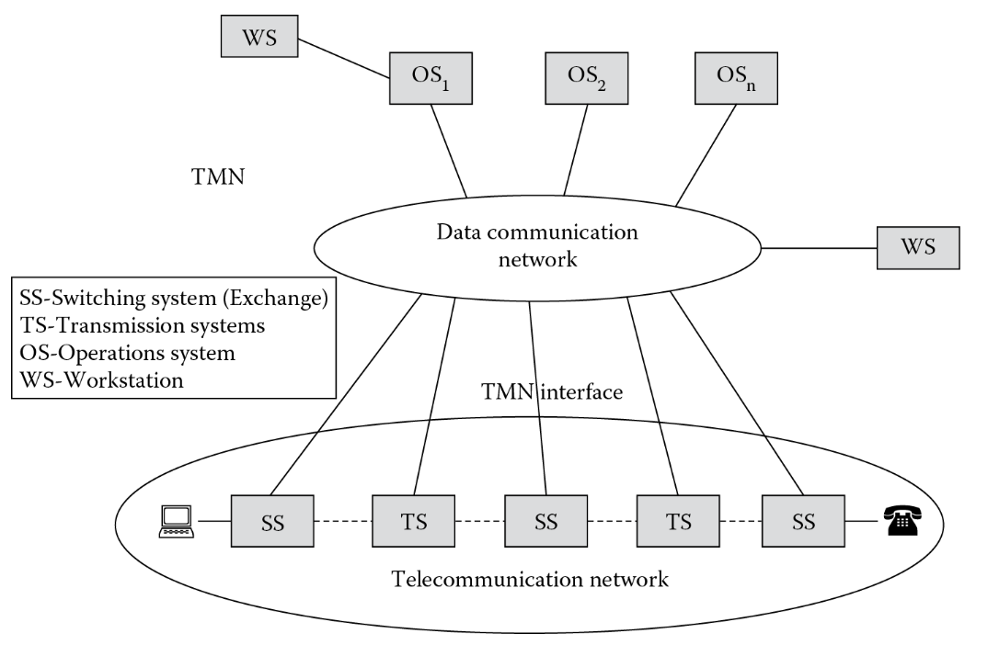
TMN Model
Why is TMN ?
A telecom network is comprised of multiple network elements.
When different vendors came up with their own custom main network elements and management solutions for the elements.
There was a need to create or identify standard interfaces that would allow a network to be managed consistently across all network element suppliers.
The TMN was a strategic goal from ITU-T toward defining these standards.
Detailed relationship of TMN with telecommunication network
Notes:
A telecom network is comprised of switching systems (exchanges) and transmission systems.
TMN is comprised of multiple operations systems. For example a separate OS for provisioning, another for traffic management, and so forth.
Operations systems perform most of the management functions.
Data communication network is used to exchange management information between the operation systems. It thus forms the link between TS/SS in telecom network and OS in TMN.
Work stations allow operators to interpret management information.
A workstation can take input from a data communication network or from an operation system.

Slide 11
TMN Model
TMN interface
TMN interface that is comprised of the following elements:
Roles and relationships of communicating TMN entities
OAM&P requirements (operation, administration, maintenance, and provisioning)
Application and resource information models
Protocols for transport of information
TMN can be said to be a set of architectures that:
Define management activities
Define tasks associated with the activity
Define data communication in the activities
Map relation between management entities and associated data, task, and activities
A set of models that:
Separate technology, network, service, and business
Define processes associated with information and management tasks
A set of protocols that:
Define communication between NE and OS
Define communication between OS and OS

Slide 12
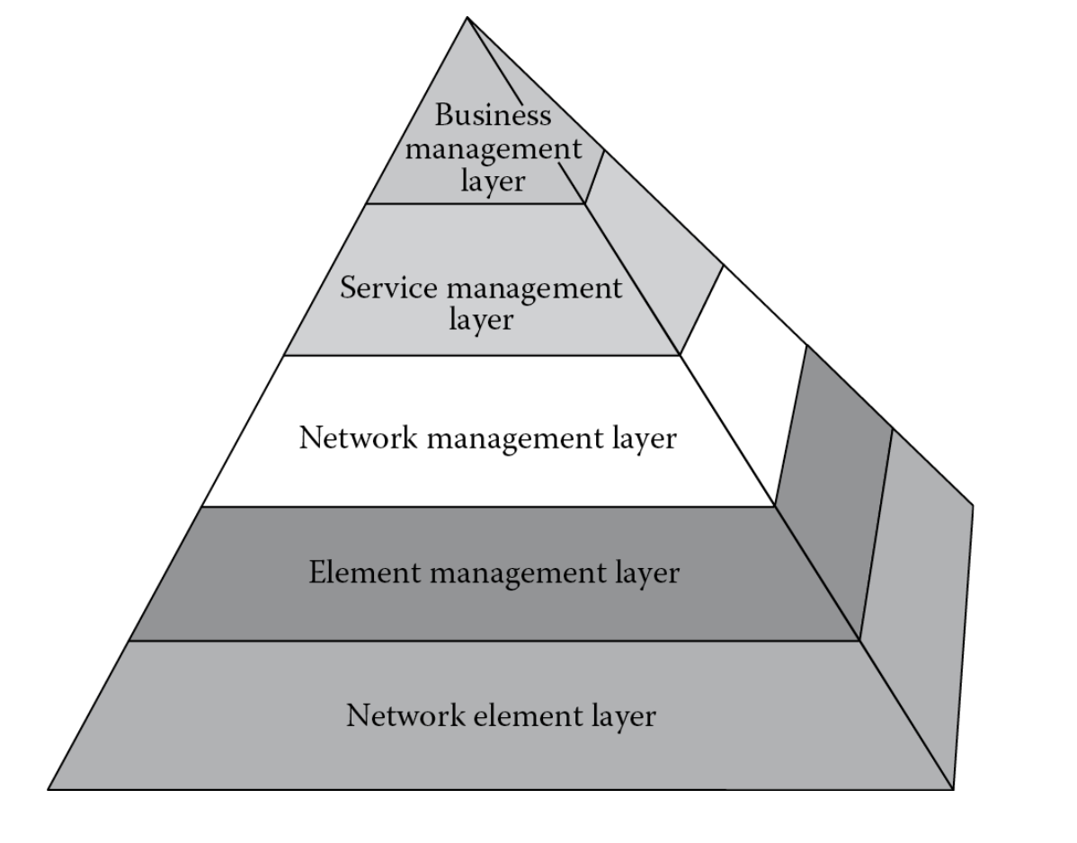
TMN Model
Logical Architecture - TMN pyramid
TMN logical architecture splits telecom management functionality into a set of hierarchal layers.
The logical architecture helps to focus on specific aspects of telecom management application development.
The TMN logical architecture forms the basic model which reduces management complexity by splitting management functionality so that specializations can be defined on each of the layers
Notes:
TMN logical architecture splits telecom management functionality into a set of hierarchal layers. This logical architecture is one of the most important contributions of TMN which helps to focus on specific aspects of telecom management application development. Though new detailed models were built based on TMN as a reference, the TMN logical architecture still forms the basic model which reduces management complexity by splitting management functionality so that specializations can be defined on each of the layers (see Figure 2.6).
The layers in the TMN logical architecture are:
Network element layer (NEL): This is the lowest layer in the model and it corresponds to the network element that needs to be managed and from which management information is collected. This layer can also include adapters to adapt between TMN and non-TMN information. So both the Q-adapter and the NE in the physical TMN model are located in the NEL and NEF and QAF functions are performed in network element layer.
Element management layer (EML): This is the layer above the network element layer and deals with management of elements in the NEL. The development of an element management system (EMS) falls in this layer and the functionalities discussed in the first chapter performed by element managers are grouped in this logical layer of TMN. When mapping it with functional architecture the OSF of the network elements are associated with this layer.
Currently, the operation support system (OSS) mostly used in association with service management applications is supposed to incorporate all management functions as in OSF of the TMN functional architecture. When we segregate management functionality into business, service, network, and element management, the business management application got associated with BSS, service management application with OSS, network management application with NMS, and element management applications with EMS.
Network management layer (NML): The responsibility of this layer is to manage the functions related to the interaction between multiple pieces of equipment.Some of the functions performed in this layer are:
Creating a view of the network
Correlation of network events
Single-sign-on to elements in the network and the element managers
Traffic management based of attributes and behavior of network elements
Monitoring network utilization and performance
A detailed discussed of network management is handled later in this book.
Service management layer (SML): This layer, as the name signifies, is concerned with managing services. Service is what is offered to the customer and hence this layer is the basic point of contact with customers. To realize any service there is an underlying network and so the SML uses information presented by NML to manage contracted service to existing and potential customers. The SML also forms the point of interaction with service providers and with other administrative domains.Some of the functions performed in this layer are:
Service provisioning
User account management
Quality of service (QoS) management
Inventory management
Monitoring service performance
A detailed discussion of service management functions is handled later in this book under OSS.
Business management layer (BML): This is the top most layer in the TMN logical architecture and is concerned with business operations.Some of the functions performed in this layer are:
High-level planning
Goal setting
Market study
Budgeting
Business-level agreements and decisions
A detailed discussion of business management functions is handled later in this book under BSS.
Associated with each layer in the TMN model are five functional areas called FCAPS that stand for fault, configuration, accounting, performance and security. These five functional areas form the basis of all network management systems for both data and telecommunications. These five functional areas will be covered in detail in the next chapter.

Slide 13
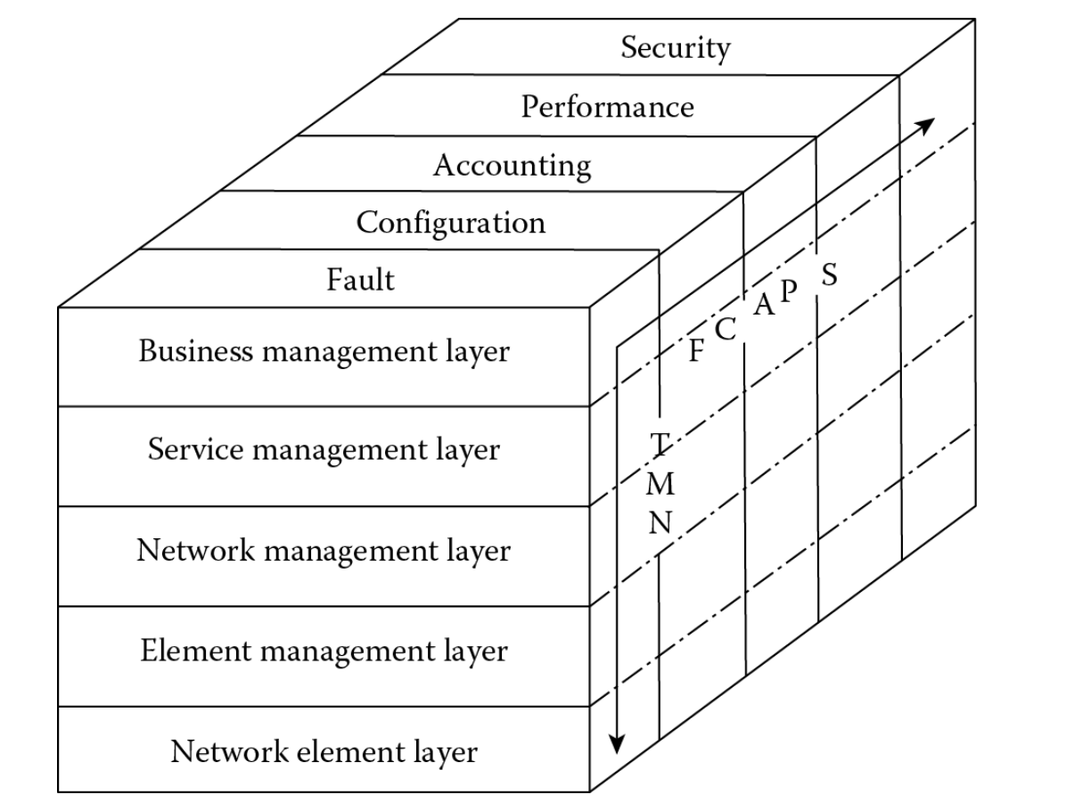
ITU-T FCAPS
The information in telecom management is classified into functional areas using FCAPS
It was introduced for telecom network management by ITU-T in recommendation M.3400.
All element management systems are expected to provide the FCAPS function or a subset of the same.
At higher levels like business, service, and network layer, derivatives of basic FCAPS functionality can be implemented (e.g)
complex event processing engine that triggers mail on business risks when network elements carrying major traffic goes down or
a service request is sent to the nearest technician or
set of commands to the network elements to replace load or restart.

Slide 14
Network Management Functions
Network/service provisioning
Network/service development and planning
Inventory management
Integrated Multivendor environment
Service assurance
Network operations support
Network/service monitoring and control

Slide 16
Management Protocols
Process or standard to manage a network of devices.
Raising an alarm, monitoring an ethernet interface, deploying a service, collecting some counters etc all are management functions

Slide 17
Different Management Protocols
CLI
Transaction Language 1 (TL1)
SNMP(v1, v2 and v3)
Model Driven Oriented
Netconf
Restconf
gRPC (gNMI)

Slide 18
CLI
Login to the Node cli, bring up a port ^
Configure a Service
Working directly on the Node
Complexity increases if number of nodes increases in the network

Slide 19
TL1
Transaction Language 1
Ascii oriented, string-based and human-readable.
Was widely used in telecommunication networks ex: SONET
4 types of messages- Input Command, Ack, Output Response, Autonomous
Commands - ACT-USER SET-ATTR-ENV SET-ATTR-CONT SET-ATTR RTRV-ATTR-ENV

Slide 20
SNMP
Simple
UDP based (Connection less)
Agent and Manager
v1, v2, v2c and v3
Very effective for Fault Management, Statistics Collection
Operations get, get-next, get-bulk, set etc
MIBs in ASN1 notation
Not scalable, no transaction based, not good for networks which need huge and frequent configuration deployment

Slide 21
Examples of SNMP Operations
snmpget -v2c -c private 135.250.199.4 .1.3.6.1.4.1.6527.3.1.2.4.2.71.1.4.22
snmpget -v 2c -c private 138.203.56.248 .1.3.6.1.2.1.1.2.0 //SysObjectOid
snmpset -v2c -c comm host OID type: value
snmpset -v2c -c private 135.250.199.227 .1.3.6.1.4.1.6527.3.1.2.14.2.5.1.2.1.116.97.114.103.101.116.58.51.58.55 i: 4
snmpset -v2c -c private 135.250.198.152 .1.3.6.1.4.1.6527.3.1.2.4.2.71.1.3.2 i: 0 .1.3.6.1.4.1.6527.3.1.2.4.2.71.1.4.2 x: ""
You can run on any device which supports SNMP^

Slide 22
Model Driven Approach
Define a Model for the Management Objects towards NMS/Network
Vendor Independent Management
NMS Application will be vendor agnostic
Adaptation layer will map from application model to device model and vice-versa
Automating Network Management is possible and very much needed with cloud based/virtual networks
More scalable as you define the model as modularized as possible
NSP uses yang modelling language to define Application Models

Slide 23
Netconf
Network Configuration protocol
Clear distinction between configuration data and data that describes operational state and statistics.
Enable operators to concentrate on the configuration of the network as a whole rather than individual devices.
Support for configuration transactions across a number of devices.
A mechanism to dump and restore configurations, and to do consistency checks
Multiple configuration data stores (candidate, running, startup)
Selective data retrieval with filtering
Extensible procedure call mechanism

Slide 24
Netconf
The Network Configuration Protocol (NETCONF) network management protocol was developed and standardized by the IETF in the NETCONF working group and published in December 2006 as RFC 4741 and later revised in June 2011 and published as RFC 6241
Provides mechanisms to install, manipulate, and delete the configuration of network devices.
NETCONF operations are realized on top of a simple RPC layer.
Uses XML based data encoding for the configuration data as well as the protocol messages.
The protocol messages are exchanged on top of a secure transport protocol.

Slide 25
Data Stores
Candidate
Running
Startup

Slide 26
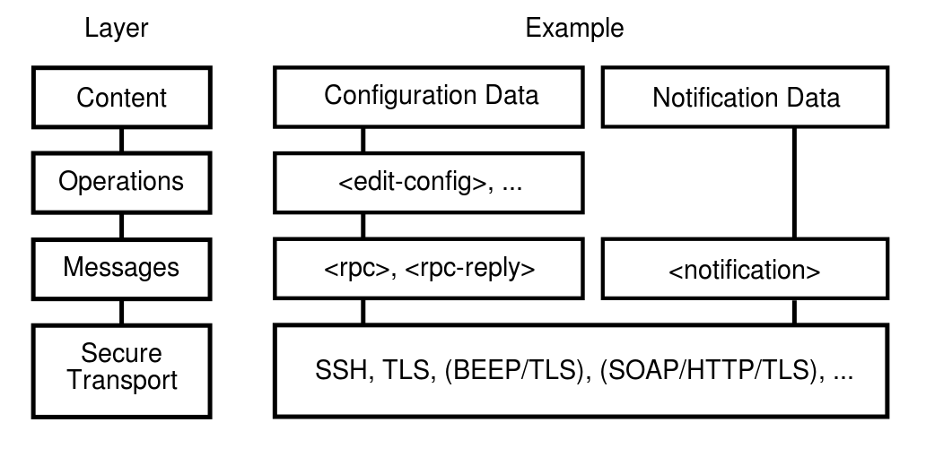
Netconf Layers
Netconf operations are realized on top of a simple RPC layer.
The NETCONF protocol can be conceptually partitioned into four layers:
The Content layer consists of configuration data and notification data.
The Operations layer defines a set of base protocol operations to retrieve and edit the configuration data.
The Messages layer provides a mechanism for encoding remote procedure calls (RPCs) and notifications.
The Secure Transport layer provides a secure and reliable transport of messages between a client and a server.

Slide 27
Netconf Operations
The base protocol defines the following protocol operations:
Operation | Description
<get> | Retrieve running configuration and device state information
<get-config> | Retrieve all or part of a specified configuration datastore
<edit-config> | Edit a configuration datastore by creating, deleting, merging or replacing content
<copy-config> | Copy an entire configuration datastore to another configuration datastore
<delete-config> | Delete a configuration datastore
<lock> | Lock an entire configuration datastore of a device
<unlock> | Release a configuration datastore lock previously obtained with the <lock> operation
<close-session> | Request graceful termination of a NETCONF session
<kill-session> | Force the termination of a NETCONF session

Slide 28
Yang
Soon after the development of the NETCONF protocol in the IETF, it became clear that a data modeling language is needed to define data models manipulated by the NETCONF protocol.
The YANG data modeling language was developed by the NETMOD working group in the Internet Engineering Task Force (IETF) and was published as RFC 6020 in October 2010.
The name is an acronym for "Yet Another Next Generation".
The syntactic structure and the base type system was essentially borrowed from SMIng.
YANG modules can be translated into an equivalent XML syntax called YANG Independent Notation (YIN)

Slide 29
Yang advantages
Designed to be human readable and easy to understand
Hierarchical configuration data models encoded in XML that can closely resemble an implementation’s native data structures
Extensibility through augmentation mechanisms, e.g. a standard module can be extended to provide additional vendor specific data/service
Rich set of standard types and possibility to create derived types, groupings (structured types) and union of types
“if”, “when”, and “choice” constructs
Supports the definition of operations (RPCs) with input and output parameters
Data modularity through modules and submodules
Versioning rules and development support

Slide 30
Yang data structures
Leaf
Leaf-list
List
Container
Module
Submodule
Grouping
Union
Choice
Show nokia yang model trees^

Slide 31
Run Netconf on SROS
Connect to the Node
Run few examples
ssh -s admin@135.249.147.245 -p 830 netconf

Slide 32
RestConf
HTTP-based protocol that provides a programmatic interface for accessing data defined in YANG, using the datastore concepts defined in the Network Configuration Protocol (NETCONF)
Content - NETCONF uses XML much. RESTCONF allows for either JSON or XML to be used.
Operations - Each of the operations are aligned to the various HTTP methods, providing the required suite of CRUD based operations (Create, Replace, Update and Delete).
Transport - The transport protocol is HTTP, allowing us to use HTTPS. Providing the security benefits that TLS has.

Slide 33
Restconf Stack/Operations
RESTCONF | NETCONF Operation | Media Type
GET | <get>, <get-config> | application/yang.data
GET | <create-subscription> | text/event-stream
POST | any <rpc> operation | application/yang.operation
PUT | replace | application/yang.data
PATCH | any edit operation | application/yang.patch
PATCH | merge | application/yang.data
DELETE | delete | application/yang.data

Slide 34
gRPC
gRPC is a modern, open source remote procedure call (RPC) framework that can run anywhere. It enables client and server applications to communicate transparently, and makes it easier to build connected systems
Low latency, highly scalable, distributed systems.
Developing mobile clients which are communicating to a cloud server.
Designing a new protocol that needs to be accurate, efficient and language independent.
Layered design to enable extension eg. authentication, load balancing, logging and monitoring etc.

Slide 35
gRPC Networking Use cases
Telemetry monitoring
Configuration Management
Whole Network Management can be done using gRPC for SROS Node
RIB Programming API
Refer: https://infocenter.nokia.com/public/7750SR160R4A/index.jsp?topic=%2Fcom.sr.router.config%2Fhtml%2Frib_api.html
Automate Operations and Tasks.
Yet to implement in SROS Nodes

Slide 36
gRPC 4 different service methods
Unary RPC:
The client sends a single request to the server and gets a single response back, just like a normal function call.
Server streaming RPC
The server and gets a stream to read a sequence of messages back. The client reads from the returned stream until there are no more messages. gRPC guarantees message ordering within an individual RPC call.
Client streaming RPC
The client writes a sequence of messages and sends them to the server, again using a provided stream. Once the client has finished writing the messages, it waits for the server to read them and return its response. Again, gRPC guarantees message ordering within an individual RPC call.
Bidirectional streaming RPC
where both sides send a sequence of messages using a read-write stream. The two streams operate independently, so clients and servers can read and write in whatever order they like: for example, the server could wait to receive all the client messages before writing its responses, or it could alternately read a message then write a message, or some other combination of reads and writes. The order of messages in each stream is preserved.

Slide 37
Show gRPC sample requests in NSP/MDM
CRUD Operarions
App to MDM
MDM to Node for SROS
OnChange Notifications using gNMI

Slide 38
Introduction to Network-aware service automation

Slide 39
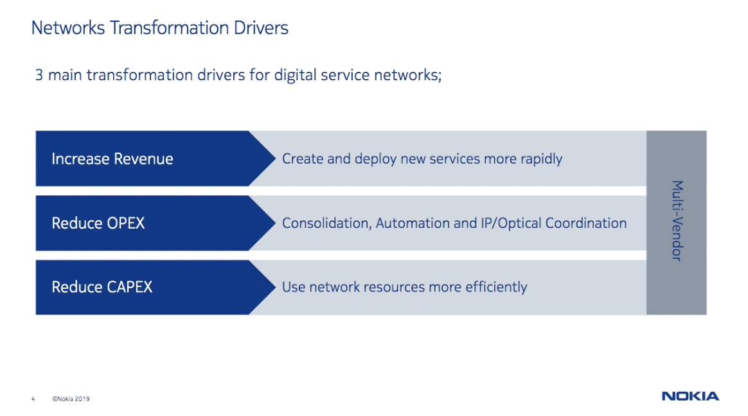
NW-tr-3pts

Slide 40
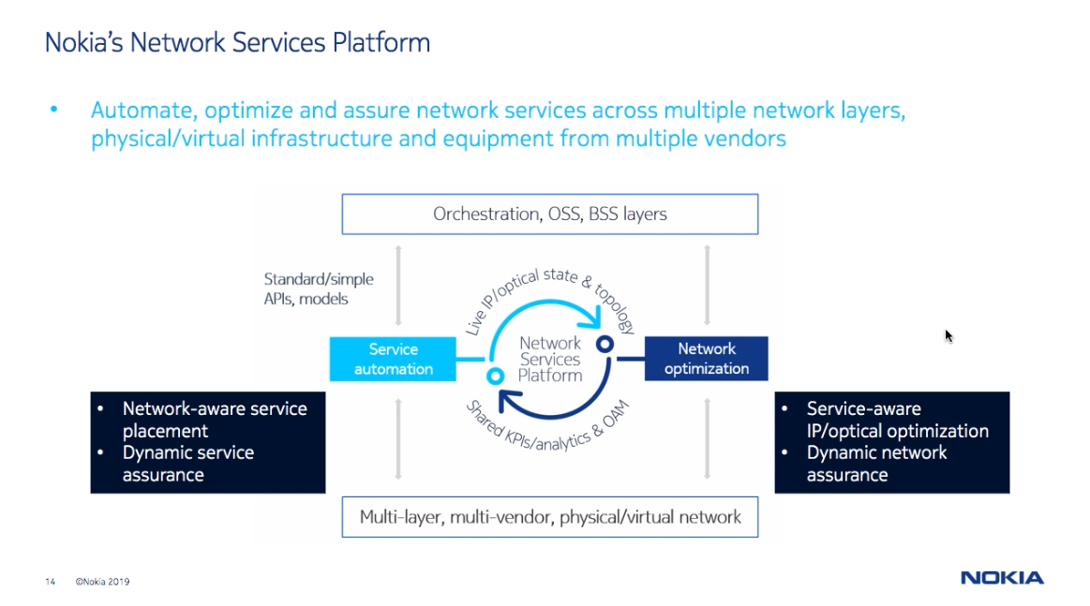

Slide 41
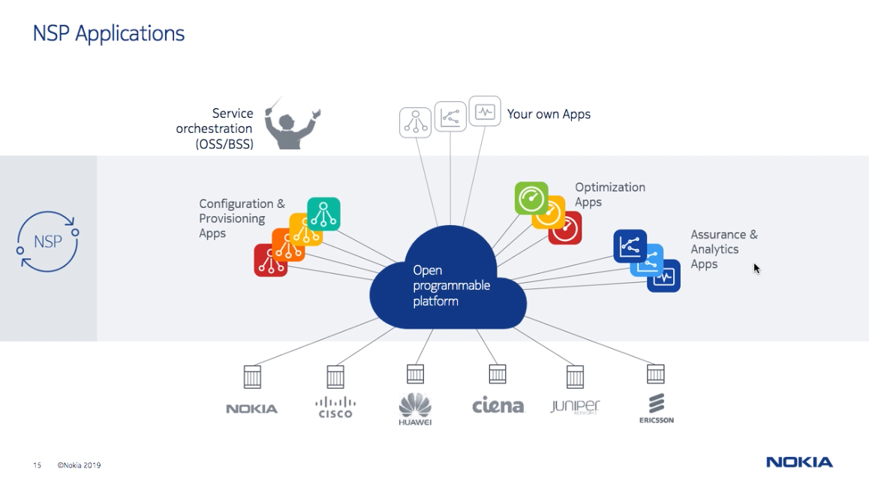

Slide 42
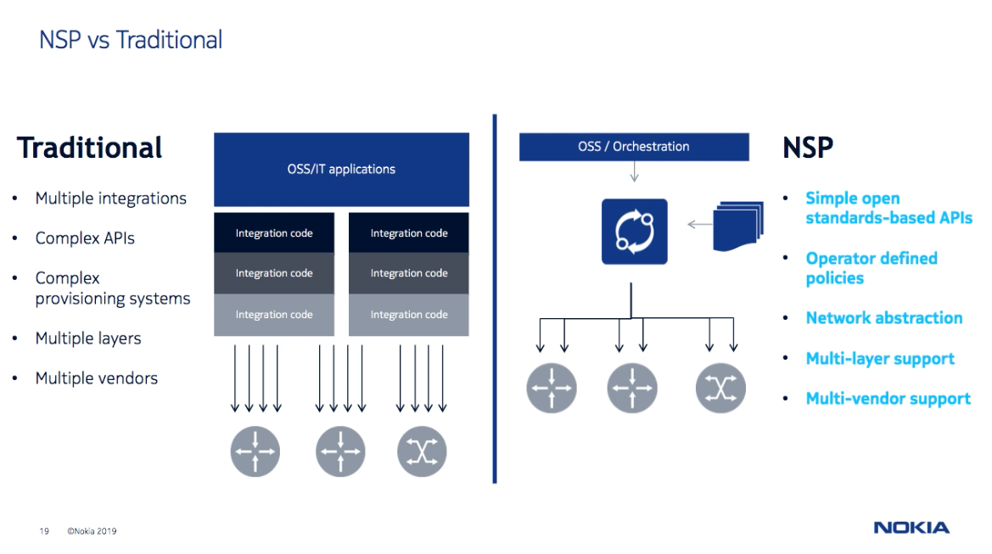

Slide 43
Network Services Platform (NSP)
Catering to different IP/Optics customer needs
Ready-to-use toolbox
Manage the network with an integrated set of result-oriented applications
Open automation platform
Automate network operations with programmable frameworks
SDN resource controller
Path/flow control and closed-loop optimization for IP/MPLS & Optical networks
Value proposition
Plug-and-play domain management system to support the continuous evolution of IP/MPLS & Optical networks
Value proposition
Open, model-driven, programmable set of APIs to integrate into customer’s own or 3rd party end-to-end OSS/ orchestration systems
Value proposition
Expert set of tools to allow network engineering teams control and optimize network traffic in real-time

Slide 44


Network Services Platform (NSP)
Target reference architecture
REST/RESTConf APIs
Real-time notifications (Kafka)
Applications
IP Management
Optical Management
Network & Service Fulfillment
Network & Service Assurance
Network Resource Control & Optimization
Cross-Domain Coordination
Data Center/ SD WAN
NSP Administration
nspOS
Microservice
Registry
Microservice
Bus
Data
Lake
Abstraction/
Automation
Frameworks
Streaming
Analytics
Framework
Common
Login
MDT/WFM
Zookeeper
Mediation Components
Model-Driven
Mediation
IP NE
Mediation
Server
Optical NE
Mediation
Server
SDN Control
Auxiliary
Data
Collector
Flow
Collector
(Telemetry)
gRPC
NETCONF
CLI
SNMP
SNMP
CLI
NETCONF
SNMP
TL1
PCEP
BGP-LS
OpenFlow
SNMP
FTP
IPFIX
SNMP

Slide 45
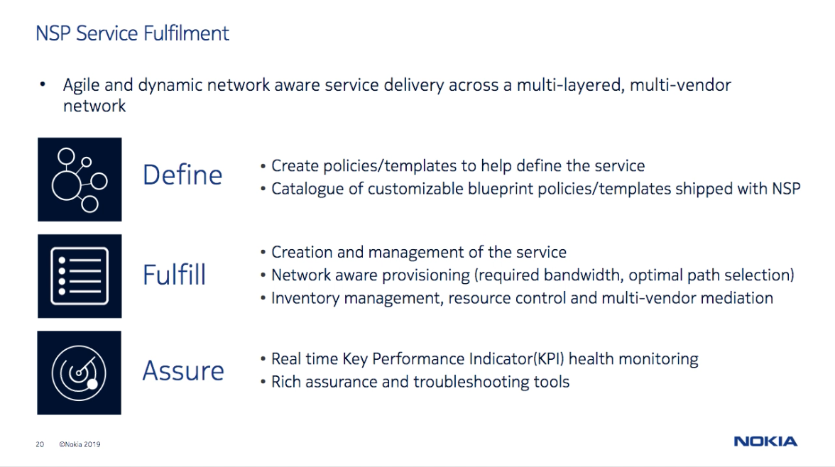

Slide 46
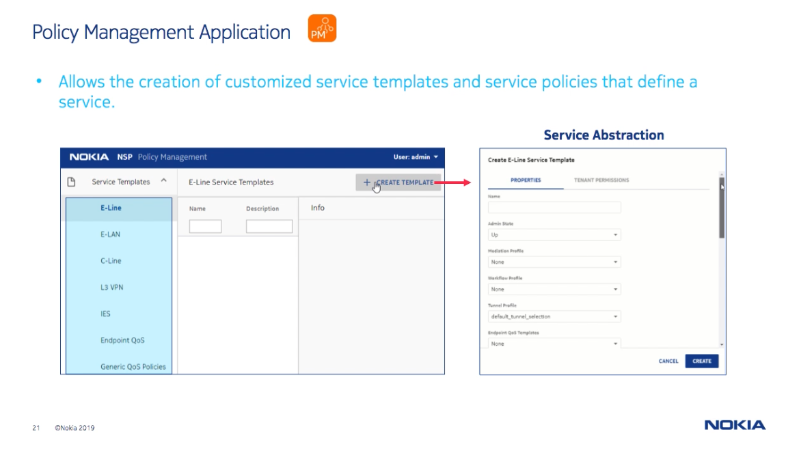

Slide 47
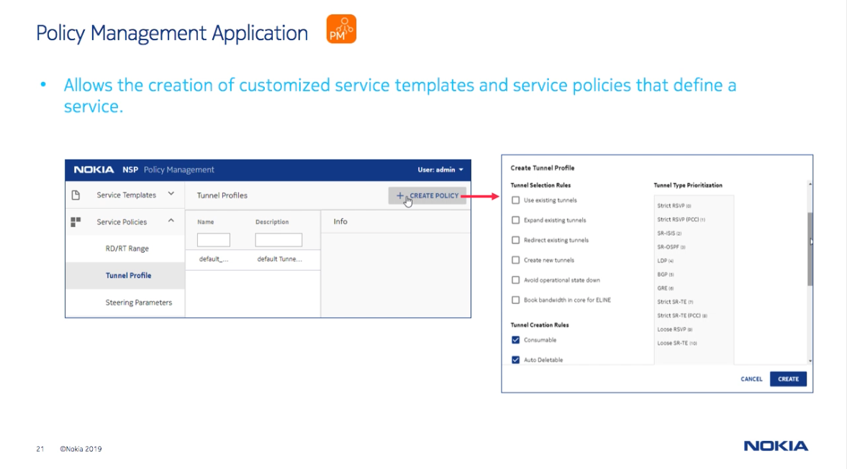

Slide 49
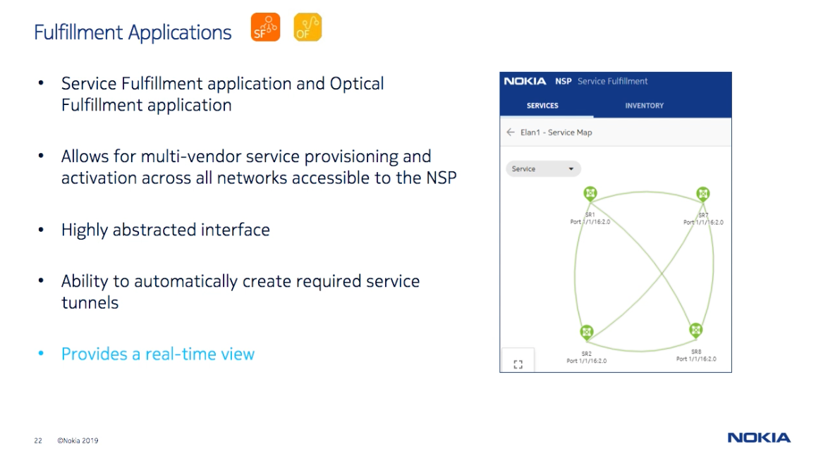

Slide 50
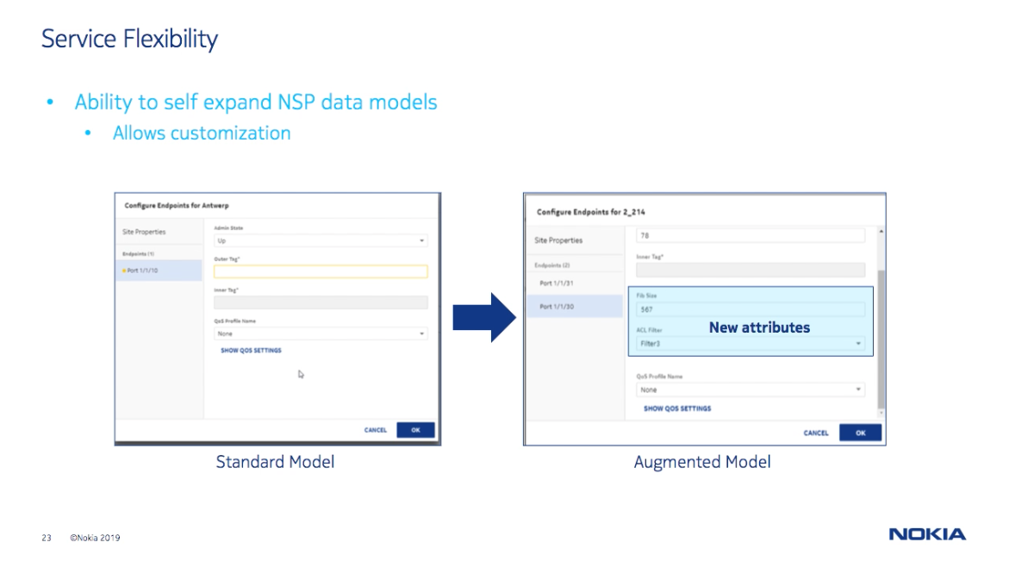

Slide 51
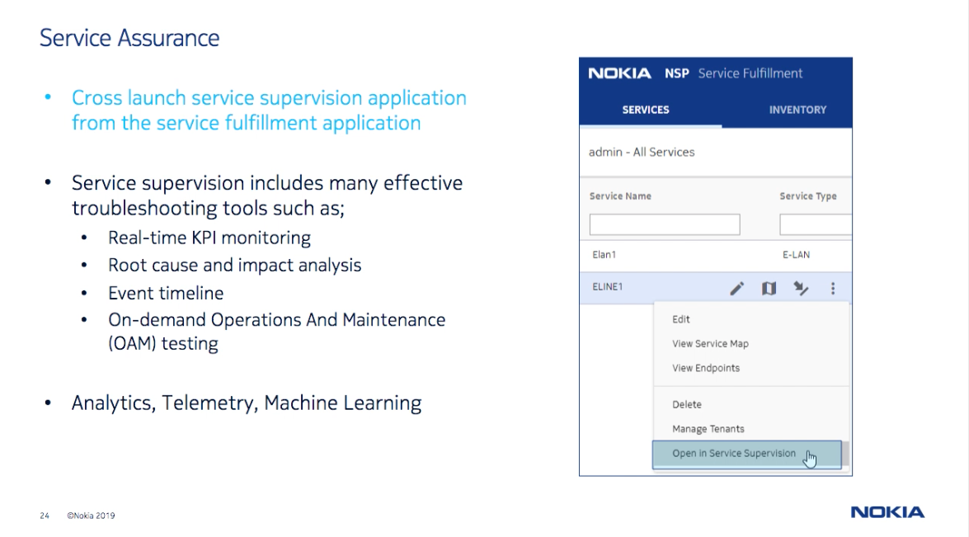

Slide 52
Network Service Director (NSD)
Solution overview
Simplified service operations
Single-step service provisioning via GUI or REST NBI speeds up fulfillment process and allows scalable & secure operations
Template-driven approach to apply & manage standard network/service configurations in the network
REST NBI can integrate with other NSP modules (i.e. WFM) or 3rd party OSS applications
Internal, vendor-agnostic L2 and L3 service data models (ELINE, CLINE, ELAN, L3VPN, IES); model augmentation support
New Workflow Manager application enables service lifecycle automation
Automated resource control and network configuration
Real-time network and resource awareness
Automated tunnel selection/deployment across mixed/new transport technologies
Policy-based path steering to ensure service optimization/SLA criteria is maintained
Integrated assurance
Multi-layer validations during service provisioning to ensure error-free service instantiation
Verify resource availability, path steering/routing, network configurations, and service connectivity
Rich correlation and visualization tools to quickly detect and troubleshoot faults and significantly reduce service downtime
Notes:
The Service Fulfillment application allows for multi-vendor service provisioning and activation across all networks accessible to the NSD. It authorizes northbound interface (NBI) service requests, executes routing algorithms that allocate network resources for these services, and then deploys the services to the network. Network deployment is performed through the mediation framework. The Service Fulfillment application can use existing tunnels or create new tunnels to satisfy service demands.
The Service Fulfillment application also provides an abstract, real-time view of the network resources that can be consumed by services, allowing service providers and end users to interact with the network through simple APIs, and to programmatically control the network. Network abstraction is used to simplify how the network appears to the IT/OSS layer. This allows services to be defined and enhanced more quickly by presenting only the subset of network services and endpoints that are relevant to a specific application, thereby greatly reducing the complexity the application is exposed to.

Slide 53
Service Fulfillment (SF) application
Target features and use cases
Application features | Use case | Value add
Simplified, abstract resource and service configuration | Create service connectivity across multi-vendor networks, devices, and endpoints | Hide network-level complexities during service provisioning; enables faster time-to-market and service initiation
Edit/modify service parameters on-demand | Port/LAG/Card/NE migrations | Update service configuration with minimal impact and downtime
 | Tunnel migration: LDP > Segment Routing | Adopt new transport technologies in a controlled way, without impacting MOPS
 | Manage QoS profiles | Increase/decrease service BW on-demand, or update path steering parameters
Automated tunnel & resource control | Ensure service SLAs are maintained | Offer enhanced, latency-based services
Save service configuration as ‘Draft’, without deploying to network | Service lifecycle management / planning | Save service configuration as DRAFT until intended/scheduled deployment
 | Pre-deployment verifications | Ensure tunnel BW and desired path availability prior to service deployment [Planned in NSP 19]

Slide 54
Extending SF functions with Model-Driven Mediation (MDM)
MDM solution overview
Provides adaptation from a set of YANG defined application models (AMI models) to a set of device models
Hot-pluggable AMI model and device adaptors
Device independent network mediation (device discovery, reachability verification)
Access native device configuration/state information
Optimized for devices supporting NETCONF/YANG
Model-driven principles: declarative, transactional
Same infrastructure and capabilities used for Nokia SR OS routers and 3rd party router
SDN
SDN
Applications
AMI Models
gRPC
Hot-pluggable
MDM
NETCONF
CLI
SNMP
Device adaptors
NE
NE
NE
NE
Device models

Slide 55
Workflow
A workflow consists of an orchestrated and repeatable pattern of business activity enabled by the systematic organization of resources into processes that provide services, or process information. It can be depicted as a sequence of operations, the work of a person or group, the work of an organization of staff, or one or more simple or complex mechanisms.

Slide 56

NSP Workflow Manager (WFM)
Values of Network Infrastructure Automation
Less error-prone
Easy to maintain
Self-documenting
Reproducible
Cost-efficient
Less time-consuming

Slide 57
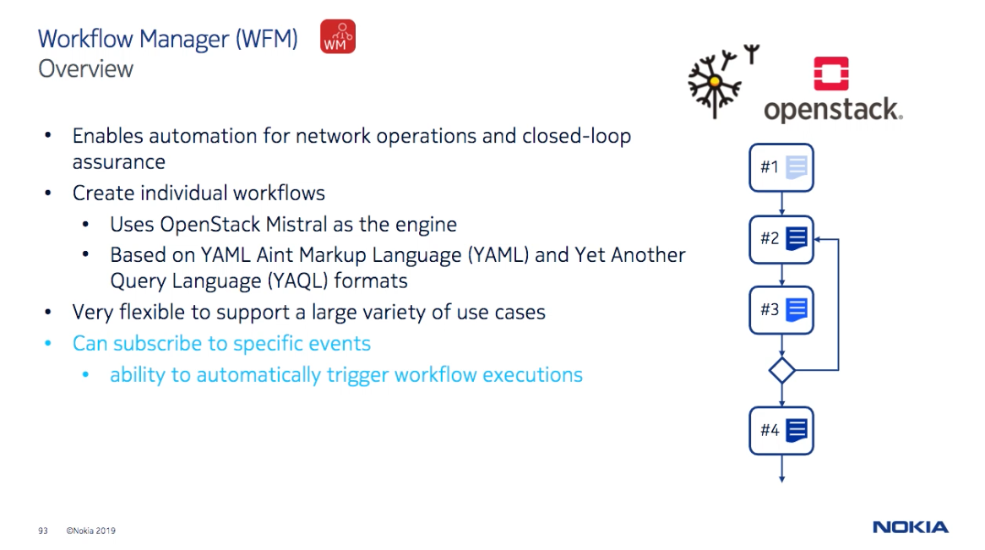

Slide 58
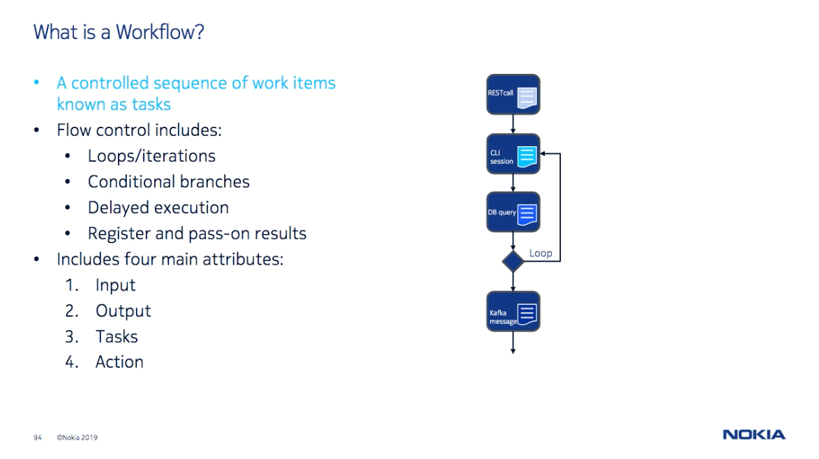

Slide 59
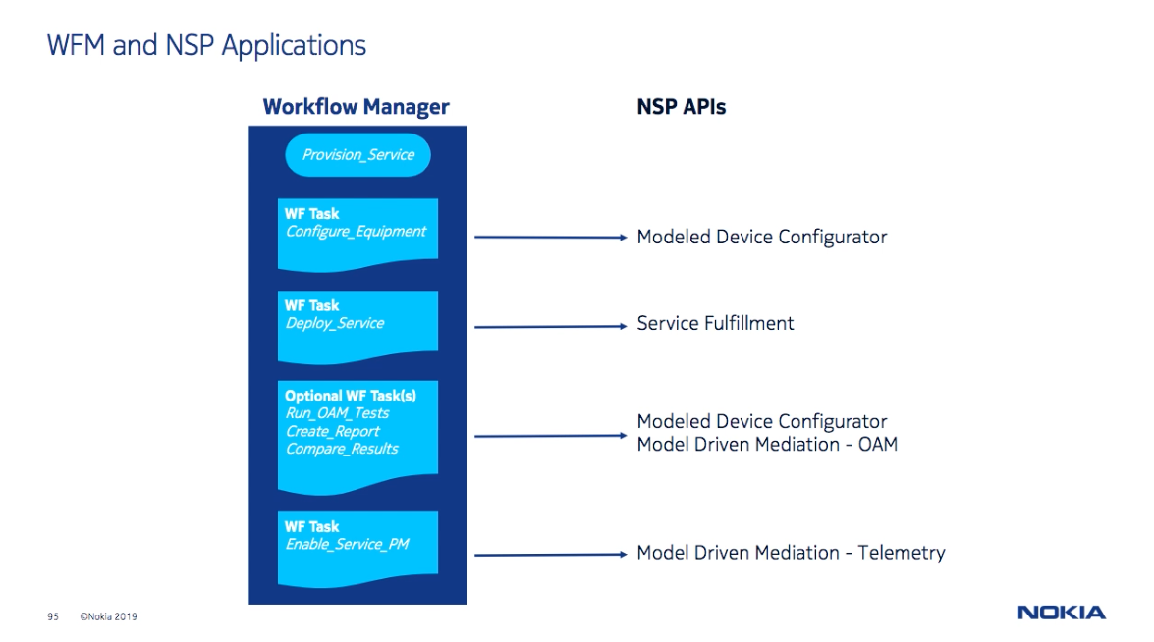

Slide 60
Summary
Comparison of NSD SF application w.r.t. NSP tools/frameworks
 | NSD SF | MDM (MDC) | WFM
Availability | Available | Available | Available
Position | Ready-to-use Toolbox | Open Programmable Platform | Open Programmable Platform
Target users | Service provisioning teams | OSS developers | OSS developers
Target use cases | Off-the-shelf, policy driven Service Fulfillment with integrated assurance (SS) | Model-driven direct access to NE for device configuration and state | Workflow automation, including service lifecycle automation
NBI | Yes (REST) | Yes (RESTConf) | Yes (REST)
Augmentation | Yes (via MDM adaptor) | Yes (via MDM cut-trough adaptor) | Yes (Hierarchical workflows)
Programmable | Limited (Templates and profiles provide some degree of flexibility) | N/A | Yes (YAML)

Slide 61
THANK YOU
Q & A

